Slide 1
AUTOMATE
Your AI partner to accompany you though your transformative journey

Slide 2
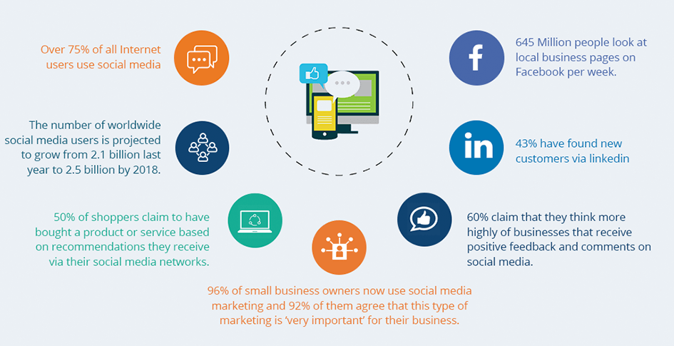
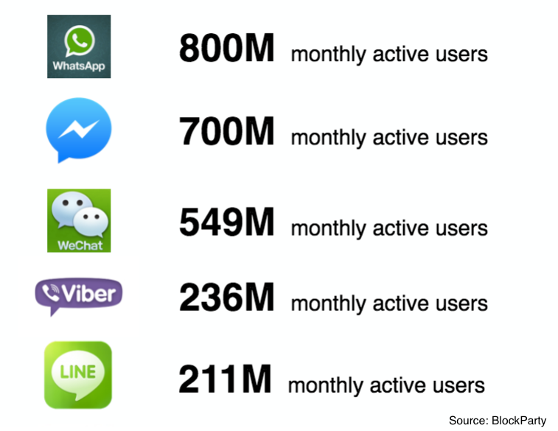
Introduction
Messaging apps are the new playground
Bots are the new apps

Slide 3
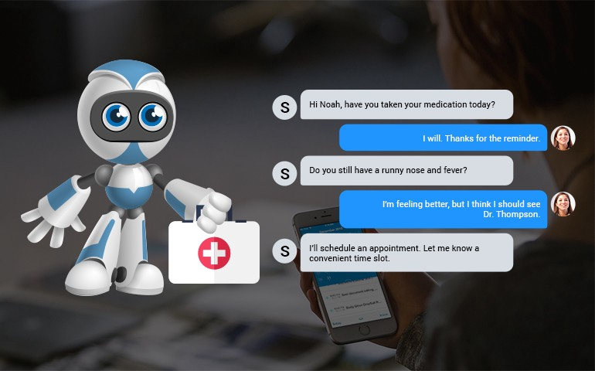
What are chatbots?
Chatbots are an innovative approach toward Human Computer Interaction(HCI)
Driven by AI, chatbots make use of natural language processing to talk to human.
Chatbots are quick and efficient way of understanding customer needs

Slide 4
Value to Business
Chatbots provide an alternative to human assistant in delivery customer services to clients.
Driven by AI, chatbots can be delivered via social platform and mobile apps that allow 24/7 interaction to manage customer need.
More and more companies are adopting chatbots to enhance their business process.
Chatbots also allow company to significantly reduce operation cost and more efficient in service delivery
Customer prefer to interact via messaging.

Slide 5
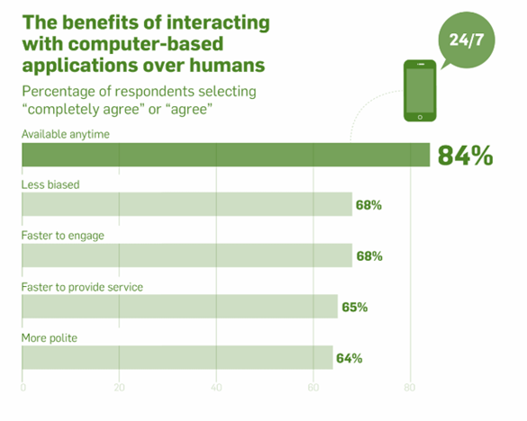
Benefits of having a chatbot?
Personality
Natural language
Empathy
Helpfulness
Persuasiveness

Slide 6
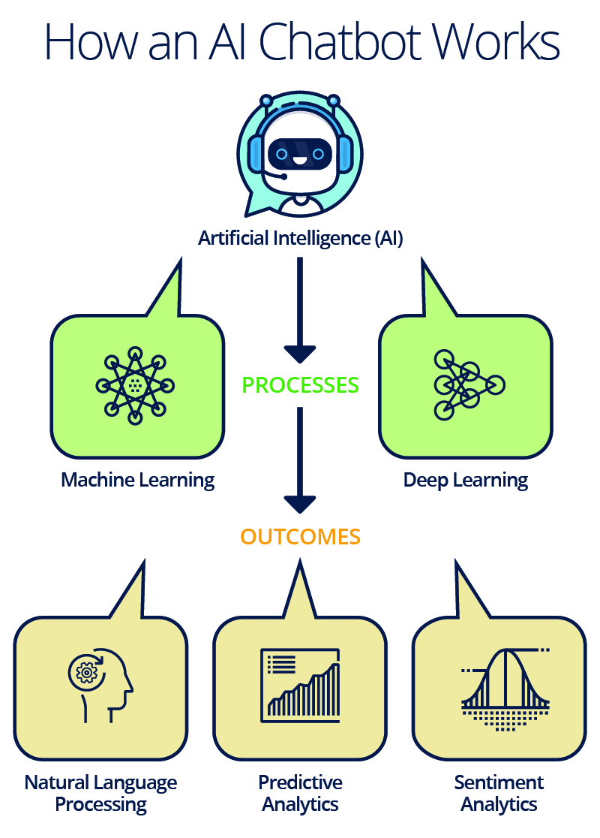
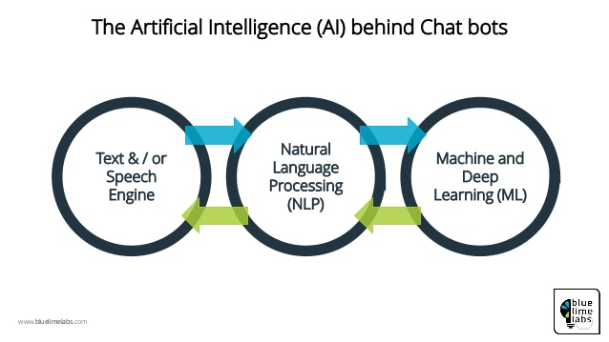
How it works?

Slide 7
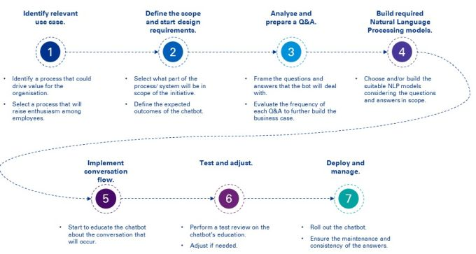
How do we work with you?

Slide 8
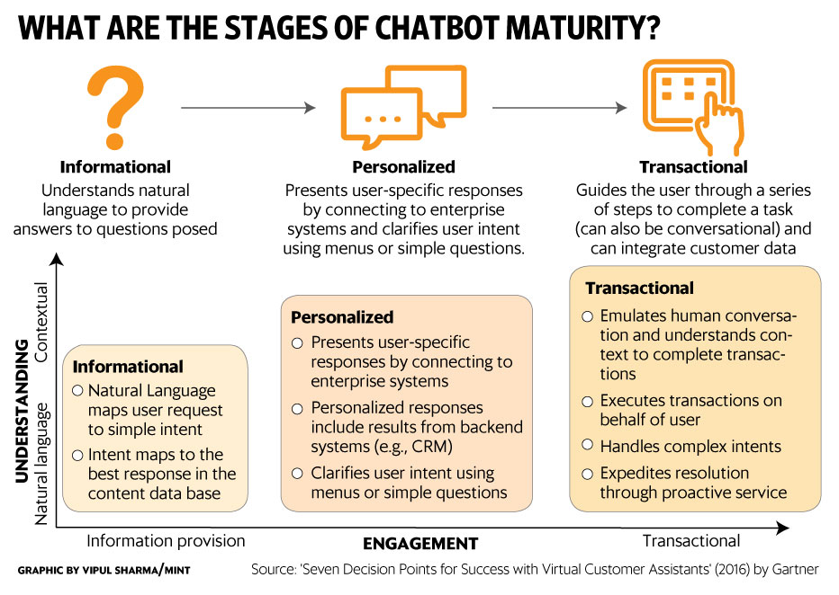
Chatbot Maturity Model

Slide 9
AUTOMATE
Thank you

